Slide 1
Data Integration
An Overview and In Depth Analysis
by
Arvind Hariharan Sankara Subramanian
Jaswanth Manigundan
Shyamsundar Dorairaj

Slide 2
Introduction
What is data integration ?
The process of gathering data from different sources by combining it and presenting in such a way, it appears to be a unified whole.

Slide 3
Foundations to Data Integration
How it all began -
Schema Integration
Query Processing
XML
Model Management
P2P Systems
Role of AI

Slide 4
Challenges in Data Integration
Like Newton’s third law states - “For every action there is an equal and opposite reaction”. There’s the ying and the yang.
Data Management
Uncertainty
Humans - Us !
Heterogeneity

Slide 5
Data Fusion
“There’s tons and tons of data out there. But when it comes to authenticity and accuracy of the data, there’s no standard and not many of the data sources are accurate. Data fusion methods resolve these conflicts by factoring truth discovery techniques by using precision and recall to validate the results.”

Slide 6
A Review of Data Fusion Methods
There are about 14 different data fusion methods, E.g.. Vote, AccuPr, PopAccu, Accucopy etc.
Based on several ongoing research - it is found that AccuCopy performs much better than the other methods and has a higher precision too.
Model | Precision
VOTE | 71%
SIM | 74%
ACCU | 79%
COPY | 83%
ACCUCOPY | 87%

Slide 7
AccuCopy Method
ACCUCOPY starts by considering the source and item trustworthiness by considering the value popularity and similarity and the copy effectiveness.

Slide 8
View Based Data Integration
View-based Data Integration is a framework in which structured data from different sources is integrated into a single unified view.
Common approaches include;
Global As View(GAV)
Local As View (LAV) and
Global and Local As View.(GLAV)

Slide 9
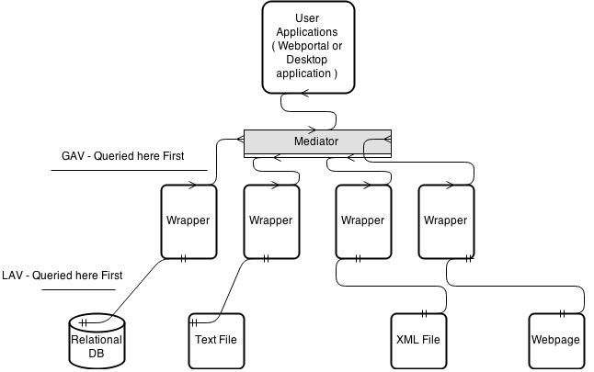
View Based Data Integration- Architecture

Slide 10
View Based Data Integration - GAV approach
In this approach the mediator turns a user query into a sequence of source queries.
Example :
Global Schema,
Phones(manufacturer , model, charging protocol)
vendor(manufacturer, model, charging protocol)
Local Schema,
(model, charging protocol)
Advantages : Simple implementation, Query answering is easy.
Disadvantages : Sources cannot be added Independently.

Slide 11
View Based Data Integration-LAV approach
In this approach the local schemas are views over the global schema, the global schema is virtual.
Example:
Global Schema
Phones(manufacturer, model, charging protocol)
vendor(manufacturer, model, charging protocol)
Local Schema
(model, charging protocol)
Advantages: Extensible, No need to know how to join different data sources.
Disadvantages: Query answering model is complex as query rewriting is needed.

Slide 12
View Based Data Integration-GLAV approach
In this approach both GAV and LAV mappings are supported.
Example :
Global Schema
Phones(manufacturer, model, charging protocol)
vendor( manufacturer, model, charging protocol)
Local Schema
(model, charging protocol)
Advantages : Extensible.
Disadvantages : Incomplete global database.

Slide 13
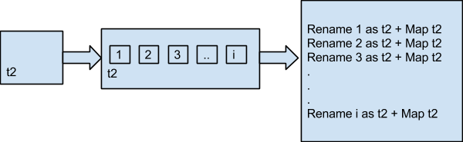
Divide and Join
Divides table into small chunks and update every table one by one – which increases speed

Slide 14
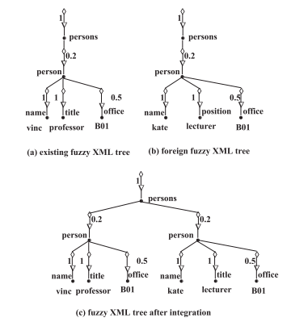
Integrating fuzzy XML documents
Method 1 –
Add new data

Slide 15
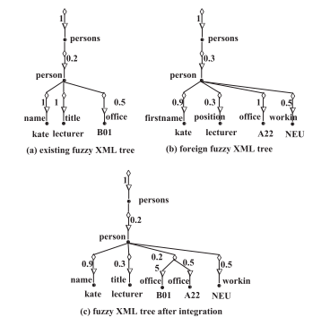
Integrating fuzzy XML documents
Method 2 –
Append to existing data

Slide 16
Comparison
Technique | Category | Design Tradeoff | Capability | Scenarios applicable
AccuCopy | Data fusion | All data fusion techniques work on the basis of voting. Design should allow this. | Supports most of the features which other data fusion techniques don’t (providers, source trustworthiness, value similarity, value formatting, copying) | Where precision is more important.
Local as View | View - based | query answering is complex | Adding sources is easy | Suited for data sources which change frequently
Global as View | View - based | simple implementation | Difficult to add sources but very simple query answering mechanism | Suited for quickfire integration.(setting up is comparatively easy)
Global and Local as View | View - based | Time taken to build a framework is more | Can add sources easily and can simply use GAV’s model of query answering. Hence, High performance | Suited for data integration systems with a long development phase.
DJDI | Data Warehouse | Complexity (cost)is more relatively | Ability to switch between techniques to save time | ready to invest for quick real time data integration
Fuzzy XML Integration | Data Warehouse | Depends on XML trees datatype | Avoids duplication and ambiguity Improved Efficiency in obtaining BI reports | works only when data comes in XML form (conversion is required otherwise)

Slide 17
Questions
What are the challenges in integrating real time data from different sources ?
Name 5 instances where real time data integration plays an integral part of the success of a system
Consider the scenario of receiving real time data from heterogeneous sources. How will you eliminate duplication and ambiguity ?

Slide 18


Thank You !

